Slide 1
Jagran Institute Of Management
Department of MCA
MASTER OF COMPUTER APPLICATION
(Second Year-2025-26-Semester:4th )
BMC-035-Software Quality Engineering
Subject Start Date: 2nd Frebruary-2026
Name of Faculty:
Vishnu Kr. Shukla
(Assistant Professor )
Department of MCA

Slide 2


Slide 3
BMC-035-Software Quality Engineering
DETAILED SYLLABUS
UNIT-I –
Software Quality: Definition, Software Quality Attributes and Specification, Cost of Quality, Defects, Faults, Failures, Defect Rate and Reliability, Defect Prevention, Reduction, and Containment, Overview of Different Types of Software Review, Introduction to Measurement and Inspection Process, Documents and Metrics.
UNIT-II-
Software Quality Metrics Product Quality Metrics: Defect Density, Customer Problems Metric, Customer Satisfaction Metrics, Function Points.
In-Process Quality Metrics: Defect Arrival Pattern, Phase-Based Defect Removal Pattern, Defect Removal Effectiveness,
Metrics for Software Maintenance: Backlog Management Index, Fix Response Time, Fix Quality, Software Quality Indicators.

Slide 4
BMC-035-Software Quality Engineering
UNIT-III-
Software Quality Management and Models: Modeling Process,
Software Reliability Models: The Rayleigh Model, Exponential Distribution and Software Reliability Growth Models, Software Reliability Allocation Models, Criteria for Model Evaluation,
Software Quality Assessment Models: Hierarchical Model of Software Quality Assessment.
UNIT-IV-
Software Quality Assurance: Quality Planning and Control, Quality Improvement Process, Evolution of Software Quality Assurance (SQA), Major SQA Activities, Major SQA Issues, Zero Defect Software, SQA Techniques, Statistical Quality Assurance, Total Quality Management, Quality Standards and Processes.

Slide 5
BMC-035-Software Quality Engineering
UNIT-V –
Software Verification, Validation & Testing: Verification and Validation, Evolutionary Nature of Verification and Validation, Impracticality of Testing all Data and Paths, Proof of Correctness, Software Testing, Functional, Structural and Error-Oriented Analysis & Testing, Static and Dynamic Testing Tools, Characteristics of Modern Testing Tools.

Slide 6
UNIT-III-
Start-

Slide 7
UNIT-III-
Software Quality Management and Models: Modeling Process,
Software Reliability Models: The Rayleigh Model, Exponential Distribution and Software Reliability Growth Models, Software Reliability Allocation Models, Criteria for Model Evaluation,
Software Quality Assessment Models: Hierarchical Model of Software Quality Assessment.

Slide 8
Software Quality Management - Introduction
Quality software refers to a software which is reasonably bug or defect free is delivered in time and within the specified budget meets the requirements and/or expectations and is maintainable.
In the software engineering context, software quality reflects both functional quality as well as structural quality.
Or
Software Quality Management ensures that the required level of quality is achieved by submitting improvements to the product development process. SQA aims to develop a culture within the team and it is seen as everyone's responsibility.

Slide 9
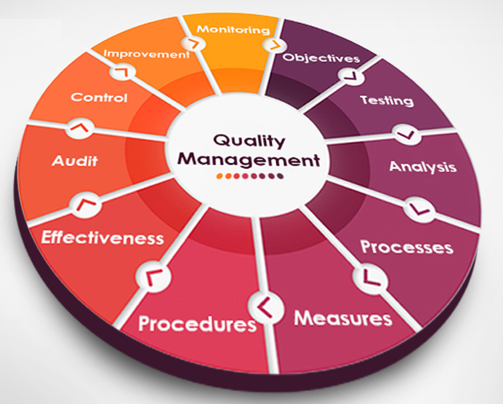

Slide 10
Software Quality management should be independent of project management to ensure independence of cost and schedule adherences. It directly affects the process quality and indirectly affects the product quality.
Activities of Software Quality Management:
Software quality management activities are generally split up into three core components: quality assurance, quality planning, and quality control. Some like software engineer and author Ian Somerville don't use the term "quality control" However, the three core components otherwise remain the same.

Slide 11
1. Quality Planning - Select applicable procedures and standards for a particular project and modify as required to develop a quality plan.
2. Software Functional Quality − It reflects how well it satisfies a given design based on the functional requirements or specifications.
3. Software Structural Quality − It deals with the handling of non-functional requirements that support the delivery of the functional requirements such as robustness or maintainability and the degree to which the software was produced correctly.
Or Quality Control - Ensure that best practices and standards are followed by the software development team to produce quality products.

Slide 12
Software Quality Assurance − Software Quality Assurance (SQA) is a set of activities to ensure the quality in software engineering processes that ultimately result in quality software products.
The activities establish and evaluate the processes that produce products. It involves process-focused action.
Or Quality Assurance -QA aims at developing Organizational procedures and standards for quality at Organizational level.
Software Quality Control − Software Quality Control (SQC) is a set of activities to ensure the quality in software products.
These activities focus on determining the defects in the actual products produced. It involves product-focused action.

Slide 13
Software Quality Management: Introduction
Software quality management (SQM) is a management process that aims to develop and manage the quality of software in such a way so as to best ensure that the product meets the quality standards expected by the customer while also meeting any necessary regulatory and developer requirements, Software quality managers require software to be tested before it is released to the market and they do this using a cyclical process-based quality assessment in order to reveal and fix bugs before release.

Slide 14
Quality management Control is the act of overseeing all activities and tasks needed to maintain a desired level of excellence. This includes the determination of a quality policy, creating and implementing quality planning and assurance, and quality control and quality improvement.
Their job is not only to ensure their software is in good shape for the consumer but also to encourage a culture of quality throughout the enterprise.

Slide 15
What is Software Quality Management
A Software quality management software is defined as a formalized system that documents processes, procedures, and responsibilities for achieving quality policies and objectives.
A SQM helps coordinate and direct an organization’s activities to meet customer and regulatory requirements and improve its effectiveness and efficiency on a continuous basis.
Quality Management Process/Quality Management System Process A Quality Management Process is a set of procedures that are followed to ensure that the deliverables produced by a team are “fit for purpose”. The start of the Quality Management Process involves setting quality targets, which are agreed with the customer.
Systems Quality Management serve many purposes, including:
Improving processes
Reducing waste
Lowering costs
Facilitating and identifying training opportunities
Engaging staff
Setting organization-wide direction.

Slide 16
Software Quality Management
Customer focus.
Leadership.
Engagement of people.
Process approach.
Improvement.
Evidence-based decision-making.
Relationship management.
The Quality Management tools and Quality Management techniques most commonly used in Quality management and process improvement are:
Check Sheet
Pareto Diagram(bar graph)
Cause And Effect Diagram
Graphs
Histograms
Control Chart
Scatter Diagram

Slide 17
What are the benefits of Software Quality Management?
Some of the benefits of Software quality are -
Increased productivity of the development team.
Improved Product Quality - Test statistics and defect tracking are more precise and up to date.
Decreased re-work costs as the detection of defects are found earlier in software project development life cycle in every stage.
Increased confidence levels in existing product management and future product development.
Increased credibility as the software produced will be highly qualitative.
Saves Money.
Inspires Client Confidence.
Maintains Great User Experience.
Brings In More Profit.
Boosts Customer Satisfaction.

Slide 18
Why Software Quality Management is important?
For a successful business that develops software, software quality must be the requirement- cannot be an exception. Consider the ways software quality can impact business.
Predictability
Software quality drives predictability. Predictability decreases as re-work grows, and lower quality product increases. Do it once and right, and there will be less variation in productivity, less re-work, and better performance overall. Products get delivered on time. Poor quality is hugely more difficult to manage.
Reputation
A significant, solid reputation is hard to establish and easy to lose, but when the company has it, it’s a powerful business driver. A few mistakes and fame can be gone, creating significant obstacles to sales, and consequently, your bottom line.
Employee Morale
The happiest and productive employees have pride in the work. Enabling employees to build software will drive a higher level of productivity and morale. Inferior products, lots of re-work, unhappy customers and difficulty making deadlines have the opposite effect, leading to a less productive workforce and high turnover.

Slide 19
Customer Satisfaction:-
A quality product satisfies the customer. A satisfied customer comes back for provides positive referrals. Customer loyalty heavily drives by the quality of the software produced and the service offer. With social media channels such as Face book and Twitter, positive references can spread quickly. Poor quality and dissatisfaction can also rapidly communicate, if not even quicker than the good ones.
Bottom Line:-
Predictable and productive performance, happy employees, a stellar reputation, and satisfied customers are the formula for a successful software business. It all drives the bottom line. Quality impact various areas of software development projects.
Big Data is the trend that is revolutionizing society and its organizations due to the capabilities it provides to take advantage of a wide variety of data.

Slide 20
How to adopt Software Quality Management?
It’s essential to lower the cost of testing and improve the quality of software. These four points will help to enhance the quality of software and improve testing efficiency.
Test at the right time
By testing earlier, will be able to detect and solve defects rather than having to resolve them at the end of the process. The software bugs identified, the longer and more expensive they are to fix. Involved testers during the requirements and design so they can help formulate a more useful framework. More than 70 percent of issues in a live environment traced back to poor conditions.
Improve testing organization
Implement specific policies to direct a consistent approach like using repeatable industry standard testing processes and training testers within this framework.

Slide 21
Innovation leads to improvement
Do not get stuck in the same old routine – embrace new approaches.
Keep reviewing
Just because specific methods have worked in the past doesn’t mean they always will. Processes of evaluation and refactoring allow the testing team to maximize efficiency by reviewing what worked well. Implement a Cause analysis process which distinguishes whether issues were a ‘testing miss,’ a ‘development miss’ or a ‘requirements or design miss.’ Identify areas for improvement throughout the whole software development process.
Performance Automation Testing continues to evolve to meet modern enterprise's growing demands.

Slide 22
What is Total Quality Management
The term Total quality management ( TQM ) was originally coined in 1985 by the Naval Air Systems Command to describe its Japanese-style management approach to quality improvement.
The term has taken on a number of meanings, depending on who is interpreting it and how they are applying it.
In general, however, it represents a style of management aimed at achieving long-term success by linking quality and customer satisfaction.
Basic to the approach is the creation of a culture in which all members of the organization participate in the improvement of processes, products, and services.

Slide 23
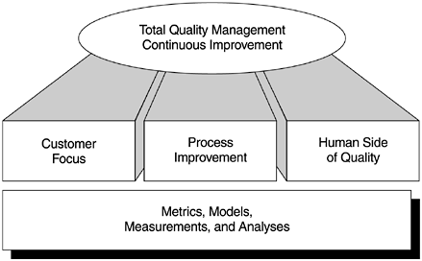
Total Quality Management
Products & Services that totally satisfy our customer needs & expectations in every respect on a continuous basis.
Despite variations in its implementation, the key elements of a TQM system can be summarized as follows :
1. Customer focus
2. Process
3. Human side of quality
4. Measurement and analysis

Slide 24
1. Customer focus: The objective is to achieve total customer satisfaction. Customer focus includes studying customers' wants and needs, gathering customers' requirements, and measuring and managing customers' satisfaction.
2. Process: The objective is to reduce process variations and to achieve continuous process improvement. This element includes both the business process and the product development process. Through process improvement, product quality will be enhanced.
3. Human side of quality: The objective is to create a companywide quality culture. Focus areas include leadership, management commitment, total participation, employee empowerment, and other social, psychological, and human factors.
4. Measurement and analysis: The objective is to drive continuous improvement in all quality parameters by the goal-oriented measurement system.
Furthermore, an organization that practices TQM must have executive leadership, must focus on infrastructure, training, and education, and must do strategic quality planning.

Slide 25
Various organizational frameworks have been proposed to improve quality that can be used to substantiate the TQM philosophy.
Specific examples include Plan-Do-Check-Act (Deming, 1986; Shewhart, 1931), Quality Improvement Paradigm/ Experience Factory Organization (Basili, 1985, 1989; Basili and Rombach, 1987, 1988; Basili et al., 1992), Software Engineering Institute (SEI) Capability Maturity Model (Humphrey, 1989; Radice et al., 1985), and Lean Enterprise Management (Womack et al., 1990).
Plan-Do-Check-Act is based on a feedback cycle for optimizing a single process or production line.
It uses techniques, such as feedback loops and statistical quality control, to experiment with methods for improvement and to build predictive models of the product.
Basic to the assumption is that a process is repeated multiple times, so that data models can be built that allow one to predict results of the process.

Slide 26
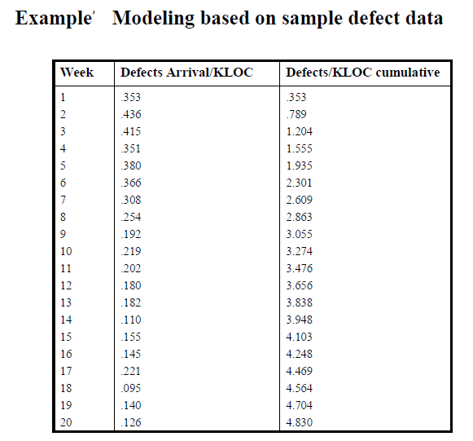

Slide 27
Software Quality Models/Software Quality Factors:-
What are software quality models?
Software Quality Models are a standardized way of measuring a software product. With the increasing trend in software industry, new applications are planned and developed everyday.
Or
Software quality models are frameworks that define and evaluate the characteristics and attributes of software quality, helping organizations understand and measure how well a software product meets specific standards and user needs.
This eventually gives rise to the need for reassuring that the product so built meets at least the expected standards.

Slide 28
Definition:
A software quality model is a structured approach to assessing and improving the quality of software products. It outlines the key aspects of quality, such as functionality, usability, reliability, and performance, and how these aspects relate to each other.
Purpose:
These models help developers, testers, and stakeholders understand the different facets of software quality, enabling them to make informed decisions about development processes, testing strategies, and quality assurance activities.
Following are few models that explains what kind of quality criteria is to be followed.

Slide 29
Common Objectives of a Software Quality Model are as Follows-
Due to revolution, there are other software quality models that are developed in the market. All of them are built with the common objectives and a common goal in consideration.
A user may have lesser requirements than the already built models and since, innovation is the mother of creation.
There are several models the market sharing a common goal according to the user demands and requirements. Enumerated, are the common objectives of a software quality model.

Slide 30
The benefits and costs of the software are symbolized in their totality with no consideration in between the attributes or the high performance of the software.
The presence, absence, of the attributes of the software can be measured objectively.
The degree to which each of the attributes present gives out the overall quality of the built software.
The attributes facilitate continuous improvement of the software in the future. It allows cause and effect of a particular change to be analyzed.

Slide 31
Modeling Process:-
1. Examine the data: plot the data points against time in the form of a scatter diagram, analyze the data informally and gain an insight into the nature of the process being
modeled.
2. Select a model or several model to fit the data based on an understanding of the test process, the data, and the assumptions of the models.
3. Estimate the parameters of the model using statistical techniques such as maximum Likelihood or least-squares methods.
4. Obtain the fitted model by substituting the estimates of the parameters into the chosen model.
5. Perform a goodness-of-fit test and assess the reasonableness of the model. If the model does not fit, a more reasonable model should be selected.
6. Make reliability predictions based on the fitted model. -To model software reliability, the following steps should be followed:

Slide 32
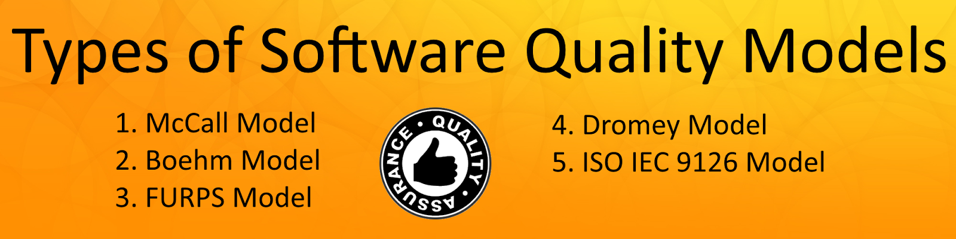
Types of Software Quality Models
1. McCall Model
2. Boehm Model
3. FURPS Model
4. Dromey Model
5. ISO IEC 9126 Model

Slide 33
1. McCall Model:-
McCall’s model was developed by the Rome air development center (RADC), the US air-force electronic system decision (ESD), general electric, in order to improve the quality of software products at software development companies.
McCall Model is the first quality model developed, which defines a layout of the various aspects that define the product's quality.
It defines the product quality in the following manner –
Product Revision
Product Operation
Product Transition

Slide 34
Three Main Perspectives of the Quality Attributes of the Software:
A perspective is required for every approach. Be it, software niche or any other niche.
Product Revision.
Product Transition.
Product Operations.
Product Revision:
It encompasses the revision perspective identifiers quality factors that changes or enhances the ability to change the software product in the future according to the needs and requirements of the user.
Maintainability- If there are defects in the software that are found in the later stage, this feature allows finding and fixing the defects.
Flexibility- The ability to make changes in the software product according to the business demands.
Testability- This enables the software product to validate the requirements.

Slide 35
Product Transition:
Transition perspective enables the software to adapt itself in new environments. The identification of the quality factor which enables the ability of adaption of the software in the new environment is known as product transition.
Let us take an example, our creator created the software named human. The creator incorporated ability to this software that enhances it to adapt in the new environment.
Portability- This is the ability to transfer a software from one environment to another environment.
Re-usability- The software components can be used in different contexts.
Interoperability- The ease or the comfort zone in which all the components of the software works together.

Slide 36
Product Operations:
The software can run successfully in the market if it according to the specifications of the user and also it should run smoothly without any defects. The product operation perspective influences the extent to which the software fulfills its specifications-
Correctness- The functionality should match the specification.
Reliability- The extent to which the system fails.
Efficiency- It enhances the usage of system resource.
Usability- The software should be easy to use. Difficult software is tedious to work upon and difficulty irks the user.

Slide 37
The model was developed to assess the relationships between external factors and product quality criteria.
The quality characteristics were classified in three major types, eleven(11) such factors which describe the external view of the software (user view), 23 quality criteria which describe the internal view of the software (developer view), and the metrics which define and are used to provide a scale and method for measurement.
The total number of factors was reduced to eleven in order to simplify it. Those factors are Correctness, Integrity, Reliability, Efficiency, Usability, Flexibility, Maintainability, Reusability, Testability, Portability, and Interoperability.
The major contribution of this model is the relationship between the quality characteristics and metrics. But, this model does not consider directly on the functionality of software products.

Slide 38
2. Boehm Model:-
Boehm added new factors to McCall’s model with emphasis on the maintainability of software product at software development companies.
The main aim of this model is to address the contemporary shortcomings of models that automatically and quantitatively evaluate the quality of software.
Thus, Boehm model represents the characteristics of the software product hierarchically in order to get contribute in the total quality.
Also, the software product evaluation considered with respect to the utility of the program. But, this model contains only a diagram without any suggestion about measuring the quality characteristics.

Slide 39
The intermediate level characteristic represents Boehm’s 7 quality factors that together represent the qualities expected from a software system:
• Portability
Reliability
• Efficiency
• Usability
• Testability
• Understand ability
• Flexibility

Slide 40
3. FURPS Model:-
FURPS model was proposed by Hewlett-Packard Co and Robert Grady. The attributes were classified into two main categories according to the user’s requirements, the functional and non-functional requirements.
FURPS Model =Functional requirements (F)+Non-functional requirements (URPS).
The FURPS-categories are defined in two different types: Functional and Non-functional.
Functional requirements (F): Functionality-Defined by input and expected output.
Non-functional requirements (URPS):Usability, reliability, performance, supportability.
Also, this model was extended by IBM Rational Software – into FURPS+.
Thus, this model considered only the user’s requirements and disregards the developer consideration.
But, this model fails to take into account the software some of the product characteristics, like maintainability and portability.

Slide 41
FURPS stands for:
Functionality – which may include feature sets, capabilities and security.
Usability - which may include human factors, aesthetics, consistency in the user interface, online and context sensitive help, wizards and agents, user documentation, and training materials.
Reliability - which may include frequency and severity of failure, recoverability, predictability, accuracy, and mean time between failure (MTBF).
Performance - imposes conditions on functional requirements such as speed, efficiency, availability, accuracy, throughput, response time, recovery time, and resource usage.
Supportability - which may include testability, extensibility, adaptability, maintainability, compatibility, configurability, serviceability, install ability, localizability (internationalization).

Slide 42
4. Dromey Model:-
Dromey (1995) states that the evaluation is different for each product, thus a dynamic idea for process modeling is required.
Thus, the main idea of the proposed model was to obtain a model broad enough to work for different systems.
Also the model seeks to increase understanding of the relationship between the attributes (characteristics) and the sub-attributes (sub-characteristics) of quality.
Also this model defined two layers, the high-level attributes and subordinate attributes.
Therefore, this model suffers from lack of criteria for measurement of software quality.

Slide 43
Dromey gives the following examples of the software components for each of the different models:
• Variables, functions, statements, etc. can be considered components of the Implementation model;
• A requirement can be considered a component of the requirements model;
• A module can be considered a component of the design model;
Dromey proposes a product based quality model that recognizes that quality evaluation differs for each product and that a more dynamic idea for modeling the process is needed to be wide enough to apply for different systems.

Slide 44
Dromey is focusing on the relationship between the quality attributes and the sub-attributes, as well as attempting to connect software product properties with software quality attributes.
Implementation, Correctness Internal Contextual Descriptive, Functionality, efficiency, reliability, Maintainability, reusability, portability, reusability, usability.

Slide 45
5. ISO IEC 9126 Model:-
As, many software quality models were proposed, the confusion happened and new standard model was required. Thus, ISO/IEC JTC1 began to develop the required consensus and encourage standardization world-wide. The ISO 9126 is part of the ISO 9000 standard, and it is the most important standard for quality assurance. The first considerations originated in 1978, and in the year 1985 the development of ISO/IEC 9126 was started.
In this model, for software development companies, the totality of software product quality attributes was classified in a hierarchical tree structure of characteristics and sub characteristics. And the highest level of this structure consists of the quality characteristics and the lowest level consists of the software quality criteria.

Slide 46
This model specified six characteristics including Functionality, the Reliability, Usability, Efficiency, Maintainability and the Portability; all of which are further divided into 21 sub characteristics.
All these sub characteristics are manifested externally when the software is used as part of a computer system, and thus are the result of internal software attributes.
All the defined characteristics are applicable to every kind of software, including computer programs and data contained in firmware and provide consistent terminology for software product quality.
And they also provide a framework for making trade-offs between software product capabilities.

Slide 47
6. Capability Maturity Model (CMM)-One of the most important quality models of software quality maintenance. The model lays down a very simple approach to define the quality standards.
It has five levels namely –
Initial Level ,
Repeatable Level,
Defined Level,
Managed Level,
Optimizing Level.

Slide 48
At the initial level, the company is quite small and it solely depends on an individual how he handles the company.
The repeatable level states that at least the basic requirements or techniques have been established and the organization has attained a certain level of success.
By the next level that is , defined, the company has already established a set of standards for smooth functioning of a software project/process.
At the managed level, an organization monitors its own activities through a data collection and analysis.
At the fifth level that is the optimizing level, constant improvement of the prevailing process becomes a priority, a lot of innovative approach is applied towards the qualitative enhancement.

Slide 49
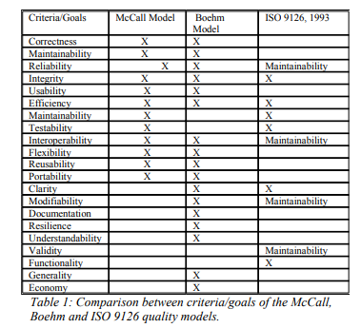

Slide 50
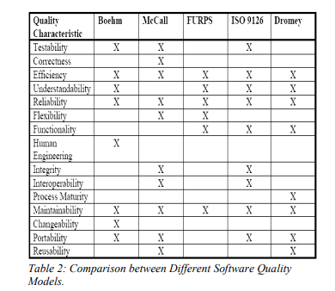

Slide 51
Software quality engineering needs a quality model that is usable throughout the software lifecycle and that it embraces all the perspectives of quality model suitable for such a purpose, through the comparative evaluation of existing quality models and their respective support Quality engineering. From the research it is observed that the:
Users play a role in the measurement of Software Quality.
Users have a direct and equal impact on the software quality.
Identifies the requirements, which needs improvement
Requires a good amount of time for the evaluation.
Can be used to improve the quality of later versions of the software.

Slide 52
Which is the best software quality model?
ISO 9126: The ISO 9126 quality model is the most useful model it has been figured on the basis of international agreements and accordance from all the countries which are members of the ISO organization

Slide 53
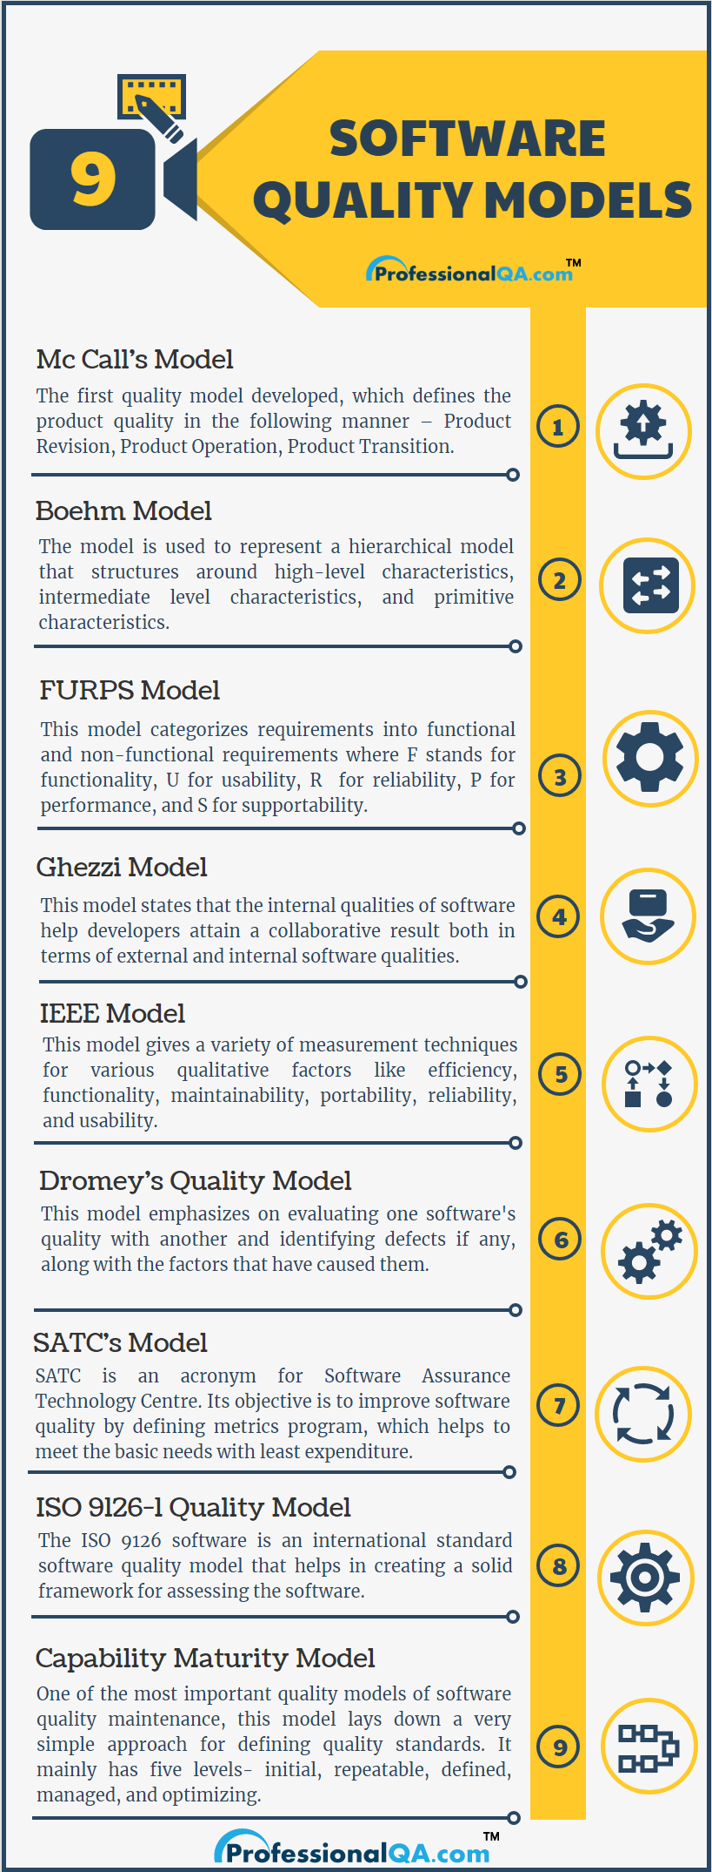

Slide 54
Software Reliability Models:-
A software reliability model indicates the form of a random process that defines the behavior of software failures to time.
“Software Reliability Model is defined as a method used in Computer Science to predict the probability of error-free operation of a computer program over a specified time period in a specific environment, based on the number of bugs present in the software” .
Software reliability models have appeared as people try to understand the features of how and why software fails, and attempt to quantify software reliability.
Over 200 models have been established since the early 1970s, but how to quantify software reliability remains mostly unsolved.

Slide 55
Software reliability can be defined as a characteristic of a software's quality that includes functionality, usability, performance, capability, maintainability, documentation, and so on.
As a software application grows, it will inevitably become more sophisticated. As a result, the estimations like its cost becomes difficult. Hence, various models have evolved, providing effective estimation techniques.
A software reliability model shows the form of a random process that describes how software failures behave over time.
There is no individual model that can be used in all situations. No model is complete or even representative.

Slide 56
Some of the Software Reliability Models that are used to achieve reliability in Software Development are-
Jelinski and Moranda Model
Basic Execution Time Model
Logarithmic Poisson Time Model
The Bug Seeding Model
Shooman Model
Littlewood-Verrall Model
Goel-Okumoto Model
Musa-Okumoto Model
Most software models contain the following parts:
Assumptions Or prediction
Factors
A mathematical function that includes the reliability with the elements. The mathematical function is generally higher-order exponential or logarithmic.

Slide 57
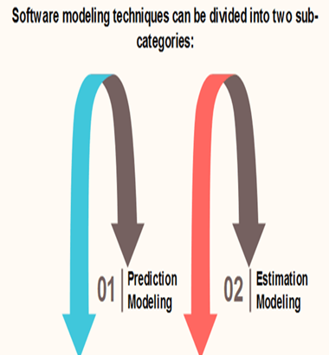
Software Reliability Modelling Techniques:-These modeling techniques are based on observing and accumulating failure data and analyzing with statistical inference. Software Reliability Modeling techniques can be divided into two categories:-
1. Estimation Models – 2. Prediction Models-
1. Estimation Models –This model uses the current
data from the current software development effort and does not take into account the conceptual development phases. It can estimate at any point
of time.
The example of Weibull Model,
Bayesian Model, J-M Model,
Goel-Okumoto Model and Thompson and
Chelson’s Model are the Estimation
Models.

Slide 58
2. Prediction Models - This model is based on historical data. They analyze past data to conclude some facts to arrive at a consensus. They are usually made before development and regular test phases. The model follows the concept phase and the prediction from the future time. Musa Model, Putnam Model, Rome Lab TR-92-52 Model, and Raleigh Model are the Prediction Models.
Musa Model : It is used to predict the failure rate before the beginning of the system testing. This model emphasizes on the assumption about the failure rate of a software based on the number of faults it contains.
Putnam Model : It is the estimation of time and effort required to complete a software project, of a particular size. It has a mathematical equation for calculating productivity levels.
Effort =[size/productivity*time].B
Where, size refers to the product size.
B is the scaling factor, a function of the project size.
Effort is the total effort in person years.
Time refers to the total time allotted for the project.

Slide 59
Difference between Prediction Models & Estimation Models
Basics | Prediction Models | Estimation Models
Data Reference | Uses historical information | Uses data from the current software development effort.
When used in development cycle | Usually made before development or test phases; can be used as early as concept phase. | Usually made later in the life cycle (after some data have been collected); not typically used in concept or development phases.
Time Frame | Predict reliability at some future time. | Estimate reliability at either present or some next time.

Slide 60
Software Reliability Model:
Such an estimate is important for two reasons:
(1) as an objective statement of the quality of the product and
(2) for resource planning for the software maintenance phase.
The criterion variable under study is the number of defects (or defect rate normalized to lines of code or function points) in specified time intervals (weeks, months, etc.), or the time between failures .

Slide 61
Reliability models can be broadly classified into two categories:
1. Static models and
2. Dynamic models.
A static model uses other attributes of the project or program modules to estimate the number of defects in the software.
A dynamic model, usually based on statistical distributions, uses the current development defect patterns to estimate end-product reliability.

Slide 62
A static model of software quality estimation has the following general form:
Where the dependent variable y is the defect rate or the number of defects, and the independent variables x i are the attributes of the product, the project, or the process through which the product is developed.
They could be size , complexity, skill level, count of decisions, and other meaningful measurements.
The error term is e (because models don't completely explain the behavior of the dependent variable).

Slide 63
Dynamic Model :-
The Rayleigh Model:- The Rayleigh model (or for that matter the phase-based defect model) provides a nice framework for quality management, covering the entire development process.
The Rayleigh model is a parametric model in the sense that it is based on a specific statistical distribution.
When the parameters of the statistical distribution are estimated based on the data from a software project, projections about the defect rate of the project can be made based on the model.

Slide 64
The Rayleigh model is a good overall model for quality management. It articulates the points on defect prevention and early defect removal related to the preceding items.
Note :-What is statistical distribution
A statistical distribution, or probability distribution, describes how values are distributed for a field. In other words, the statistical distribution shows which values are common and uncommon. There are many kinds of statistical distributions, including the bell-shaped normal distribution.
A probability distribution is a mathematical function that describes the probability of different possible values of a variable. Probability distributions are often depicted using graphs or probability tables.

Slide 65
Weibull Distribution :-One of the most widely used distributions in reliability engineering is “Weibull Distribution“. It is a kind of versatile distribution that can take the values from the other distributions using the parameter called the shape parameter.
In this article, let us discuss the definition of Weibull distribution, formulas, properties, reliability,
Weibull Distribution Definition
The Weibull Distribution is a continuous probability distribution used to analyse life data, model failure times and access product reliability. It can also fit a huge range of data from many other fields like economics, hydrology, biology, engineering sciences. It is an extreme value of probability distribution which is frequently used to model the reliability, survival, wind speeds and other data.

Slide 66
The only reason to use Weibull distribution is because of its flexibility. Because it can simulate various distributions like normal and exponential distributions.
Weibull’s distribution reliability is measured with the help of parameters.
The two versions of Weibull probability density function(pdf) are
Two parameter pdf
Three parameter pdf

Slide 67


Weibull Distribution Formulas
The formula general Weibull Distribution for three-parameter pdf is given as
Where γ is the shape parameter, also called as the Weibull slope or the threshold parameter.
α is the scale parameter, also called the characteristic life parameter.
μ is the location parameter, also called the waiting time parameter or sometimes the shift parameter.
The standard Weibull distribution is derived, when μ=0 and α =1, the formula is reduced and it becomes

Slide 68

Two-Parameter Weibull Distribution
The formula is practically similar to the three parameters Weibull, except that μ isn’t included:
The failure rate is determined by the value of the shape parameter γ.
If γ < 1, then the failure rate decreases with time
If γ = 1, then the failure rate is constant
If γ > 1, the failure rate increases with time

Slide 69
Weibull Plot
The fit of Weibull distribution to data can be visually assessed using a Weibull plot. In other words, it is a graphical method for showing if a data set originates from a population that would inevitably be fit by a two-parameter Weibull distribution where the location is expected to be zero. This plot has unique scales that are designed so that if the data do support a Weibull distribution, the points will be linear or approximately linear. The least-squares fit of this line generates estimates for the shape and scale parameters of the Weibull distribution. In this case, the location is assumed to be zero. Precisely, the scale parameter is the exponent of the intercept and the shape parameter is the reciprocal of the slope of the fitted line. Thus, the below figure is a Weibull plot of a two-parameter distribution

Slide 70
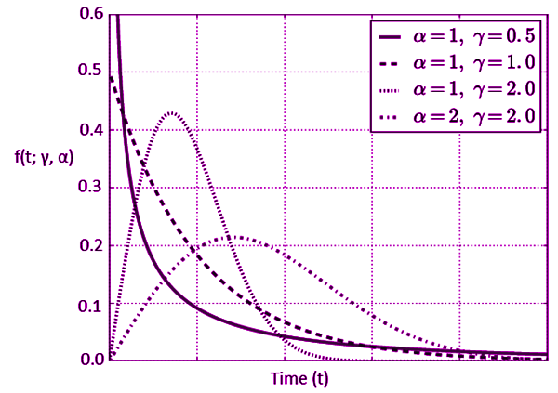

Slide 71
The Rayleigh Model:
The Rayleigh model is a member of the family of the Weibull distribution. The Weibull distribution has been used for decades in various fields of engineering for reliability analysis, ranging from the fatigue life of deep-groove ball bearings to electron tube failures and the overflow incidence of rivers.
It is one of the three known extreme-value distributions (Tobias, 1986). One of its marked characteristics is that the tail of its probability density function approaches zero asymptotically, but never reaches it. Its cumulative distribution function (CDF) and probability density function (PDF) are:

Slide 72
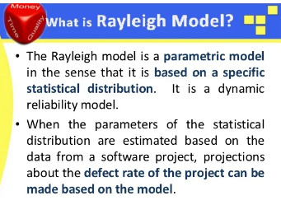

Slide 73


Slide 74
where m is the shape parameter, c is the scale parameter, and t is time. When applied to software, the PDF often means the defect density (rate) over time or the defect arrival pattern and the CDF means the cumulative defect arrival pattern.
Figure shows several Weibull probability density curves with varying values for the shape parameter m . For reliability applications in an engineering field, the choice of a specific model is not arbitrary. The underlying assumptions must be considered and the model must be supported by empirical data. Of the Weibull family, the two models that have been applied in software reliability are the models with the shape parameter value m = 2 and m = 1.

Slide 75
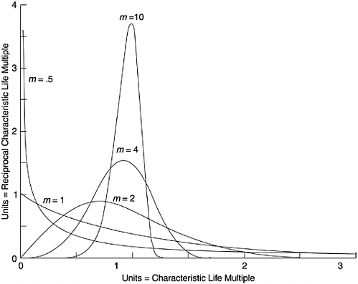
Figure :1

Slide 76
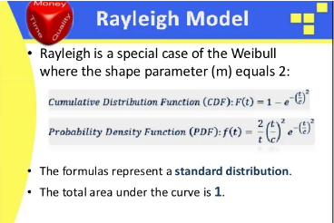
The Rayleigh model is a special case of the Weibull distribution when m = 2. Its CDF and PDF are:

Slide 77
The Rayleigh PDF first increases to a peak and then decreases at a decelerating rate. The c parameter is a function of t m , the time at which the curve reaches its peak. By taking the derivative of f ( t ) with respect to t , setting it to zero and solving the equation, t m can be obtained.
in the formulas, we get the following. To specify a model from a set of data points, K and t m are the parameters that need to be estimated.

Slide 78


Slide 79
It has been empirically well established that software projects follow a lifecycle pattern described by the Rayleigh density curve (Norden, 1963; Putnam, 1978).
Early applications of the model in software were mainly for staffing estimation over time for the life cycle of software projects. More recent work demonstrated that the defect removal pattern of software projects also follows the Rayleigh pattern.
In 1982 Trachtenberg (1982) examined the month-by-month error histories of software projects and found that the composite error pattern of those projects resembled a Rayleigh-like curve.
In 1984 Gaffney of the IBM Federal Systems Division reported the development of a model based on defect counts at six phases of the development process commonly used in IBM: high-level design inspections, low-level design inspections, code inspections, unit test, integration test, and system test.
Gaffney observed that the defect pattern of his data by the six-phase development process followed a Rayleigh curve. Following the system test phase is the phase of field use (customer use). The number of latent defects in the field is the target for estimation

Slide 80
By developing a Rayleigh model to fit his data, Gaffney was able to project the expected latent defects in the field. Putnam's work includes the application of the Rayleigh model in estimating the number of software defects, in addition to his well-known work on software size and resource estimation (Putnam and Myers, 1992). By validating the model with systems for which defect data are available (including the space shuttle development and radar development projects), Putnam and Myers (1992) found that the total actual defects were within 5% to 10% of the defects predicted from the model. Data fits of a few other systems, for which the validity of the data is doubtful, however, were not so good. As in Trachtenberg's study, the time unit for the Rayleigh model in Putnam and Myers's application is expressed in terms of months from the project start.
Figure 2 shows a Rayleigh curve that models the defect removal pattern of an IBM AS/400 product in relation to a six-step development process, which is very similar to that used by Gaffney. Given the defect removal pattern up through system test (ST), the purpose is to estimate the defect rate when the product is shipped: the post general-availability phase (GA) in the figure. In this example the X -axis is the development phase, which can be regarded as one form of logical equivalent of time. The phases other than ST and GA in the figure are: high-level design review (I0), low-level design review (I1), code inspection (I2), unit test (UT), and component test (CT).

Slide 81
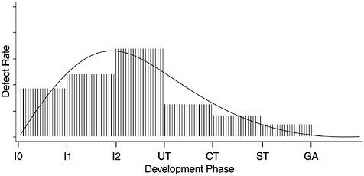
Figure -2

Slide 82
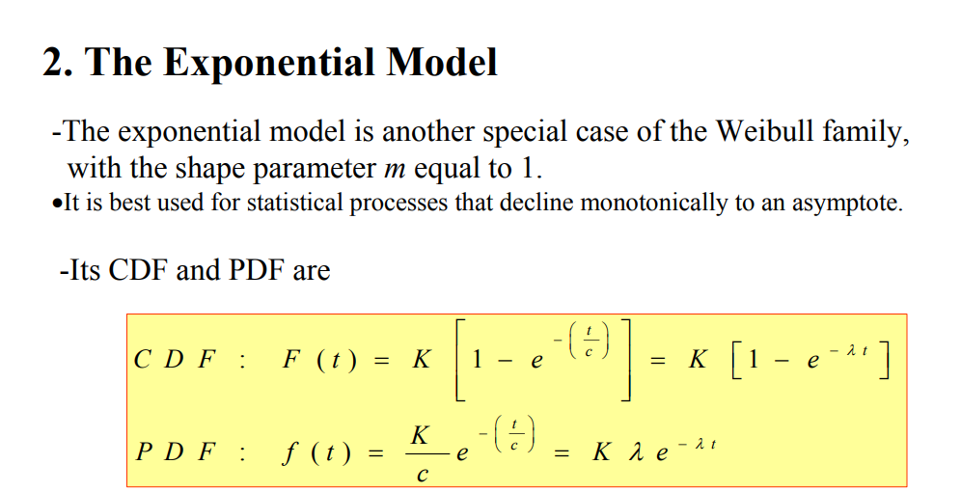

Slide 83
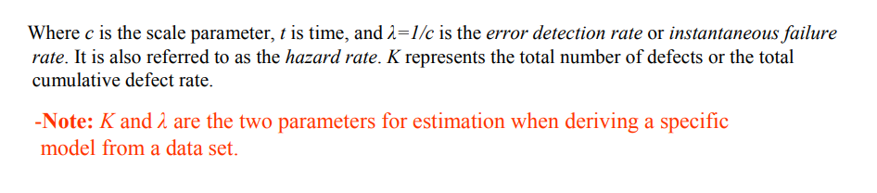
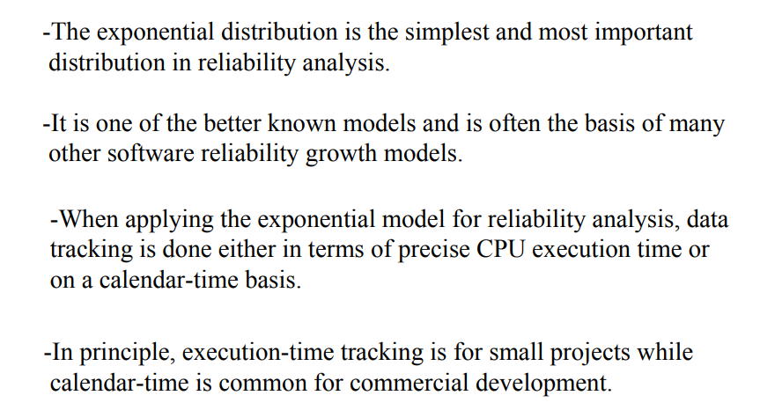

Slide 84
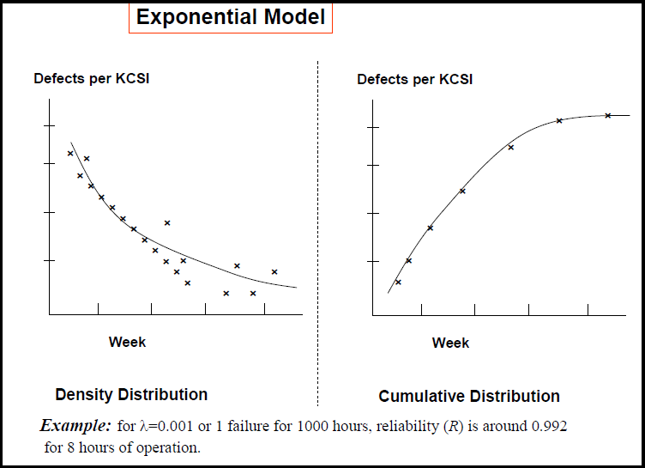

Slide 85
Software Reliability Growth Models:-The reliability growth group of models measures and predicts the improvement of reliability programs through the testing process.
The growth model represents the reliability or failure rate of a system as a function of time or the number of test cases.
A reliability growth model is a simulation of how system dependability evolves overtime throughout the testing process.
When system failures are identified, the underlying flaws that are generating these failures are corrected, and the system's dependability should improve through system testing and debugging.

Slide 86
Software Reliability Growth Modeling:-
A reliability growth model is a simulation of how system dependability evolves overtime throughout the testing process. When system failures are identified, the underlying flaws that are generating these failures are corrected, and the system's dependability should improve through system testing and debugging.
The conceptual reliability growth model must next be converted into a mathematical model in order to forecast dependability.

Slide 87
Reliability growth modeling entails comparing observed reliability at various periods in time with known functions that demonstrate potential changes in reliability. An equal step function, for example, implies that the dependability of a system rises linearly with each release.
It is feasible to forecast the system's dependability at some future point in time by comparing observed reliability increase with one of these functions. As a result, reliability growth models may be utilized to help in project planning.
The reliability growth model group measures and forecasts the improvement of reliability programs through testing.

Slide 88
The growth model depicts a system's dependability or failure rate as a function of time or the number of test cases. The models in this category are listed below.
1. Coutinho Model
In the log-log paper, Coutinho charted the cumulative number of defects identified and the number of corrective measures taken vs. the cumulative testing weeks. Let N(t) represent the total number of failures and t represent the entire testing duration. The model's failure rate, lambda (t), may be represented as,
[Math Processing Error]λ(t)=N(t)/t=β0t−β1
where [Math Processing Error]β0 are [Math Processing Error]β1 model parameters. This model's parameters may be estimated using the least-squares approach.

Slide 89
2. Wall and Ferguson Model
The total number of failures at time t, m(t), may be written as,
[Math Processing Error]m(t)=a0[b(t)]3
where alpha0: and alpha1: are unidentified parameters The number of test cases or total testing time can be used to calculate the function b(t). Similarly, at time t, the failure rate function is given by,
[Math Processing Error]λ(t)=m′(t)=a0βb′(t)[b(t)]β−1
Wall and Ferguson evaluated their model using a variety of software failure data and discovered that the failure data correlated well with the model.

Slide 90
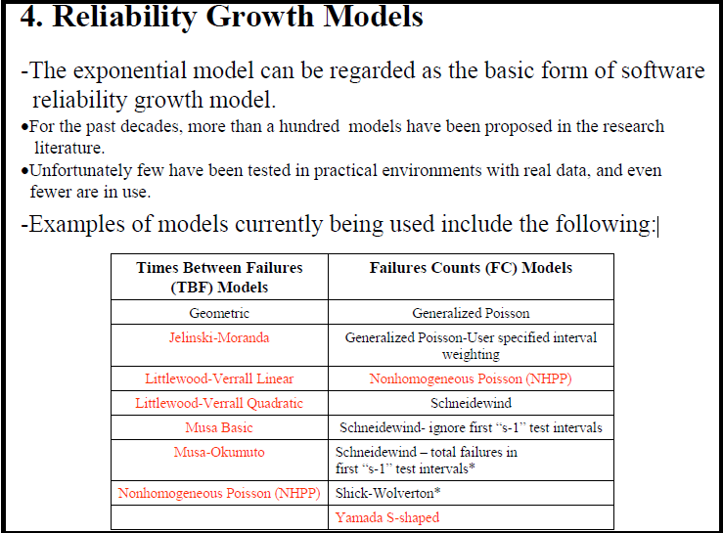

Slide 91
Notions of Reliability Growth Model:-
-In contrast to Rayleigh, which models the defect pattern of the entire development process, reliability growth models are usually based on data from the formal testing phases.
•In practice, such models are applied during the final testing phase when the development is virtually completed.
•The rationale is that defect arrival or failure patterns during such testing are good indicators of the product’s reliability when it is used by customers.
•During such post-development testing, when failures occur and defects are identified and fixed, the software becomes more stable, and reliability grows over time.
•Hence models that address such a process are called reliability growth models.

Slide 92
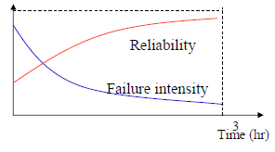
There are two types of models:
those that predict times between failures, and
those that predict the number of failures that
will be found in future test intervals.

Slide 93
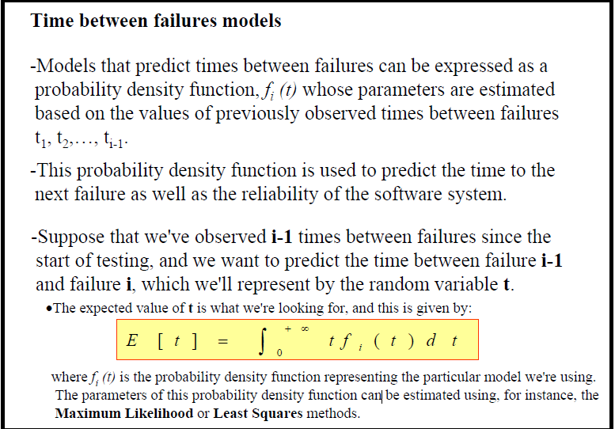
1. Time between failures models:-

Slide 94
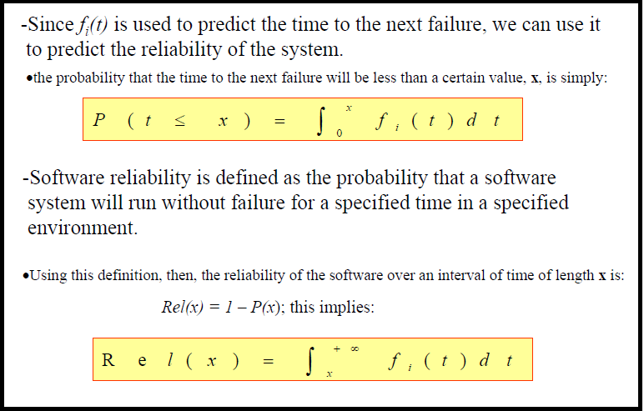

Slide 95
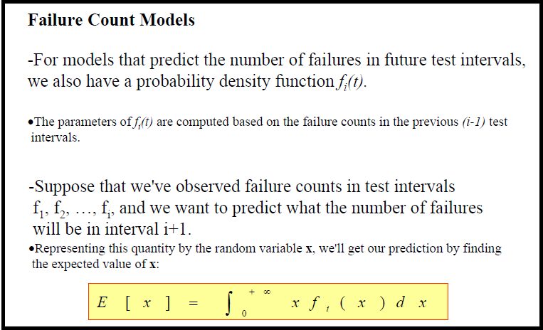
2. Failure Count Models

Slide 96
The conceptual reliability growth model must next be converted into a mathematical model in order to forecast dependability.
Reliability growth modeling entails comparing observed reliability at various periods in time with known functions that demonstrate potential changes in reliability.
An equal step function, for example, implies that the dependability of a system rises linearly with each release.
It is feasible to forecast the system's dependability at some future point in time by comparing observed reliability increase with one of these functions.
As a result, reliability growth models may be utilized to help in project planning.

Slide 97
The reliability growth model group measures and forecasts the improvement of reliability programs through testing. The growth model depicts a system's dependability or failure rate as a function of time or the number of test cases. The models in this category are listed below.
The exponential model can be regarded as the basic form of the software reliability growth models. For the past two decades, software reliability modeling has been one of the most active areas in software engineering.
More than a hundred models have been proposed in professional journals and at software conferences, each with its own assumptions, applicability, and limitations. Unfortunately, not many models have been tested in practical environments with real data, and even fewer models are in use.
1. Coutinho Model
2. Wall and Ferguson Model
From the practical software development point of view, for some models the cost of gathering data is too expensive; some models are not understandable; and some simply do not work when examined.

Slide 98
For instance, Elbert and associates (1992) examined seven reliability models with data from a large and complex software system that contained millions of lines of source code.
They found that some models gave reasonable results, and others provided unrealistic estimates. Despite a good fit between the model and the data, some models predicted the prob-ability of error detection as a negative value.
The range of the estimates of the defects of the system from these models is incredibly wide ”from 5 to 6 defects up to 50,000.

Slide 99
For the time between failures models, the variable under study is the time between failures. This is the earliest class of models proposed for software reliability assessment.
It is expected that the failure times will get longer as defects are removed from the software product.
A common approach of this class of model is to assume that the time between, say, the ( i - 1)st and the i th failures follows a distribution whose parameters are related to the number of latent defects remaining in the product after the (i - 1)st failure.
The distribution used is supposed to reflect the improvement in reliability as defects are detected and removed from the product.
The parameters of the distribution are to be estimated from the observed values of times between failures. Mean time to next failure is usually the parameter to be estimated for the model.

Slide 100
https://www.analytixlabs.co.in/blog/types-of-distribution/
https://www.scribbr.com/statistics/probability-distributions/
https://www.mycompiler.io/new/octave
https://www.w3schools.com/python/numpy/numpy_random_rayleigh.asp
https://en.wikipedia.org/wiki/Rayleigh_distribution
https://in.mathworks.com/help/stats/rayleigh-distribution.html
https://www.w3schools.com/python/numpy/numpy_random_rayleigh.asp
https://www.statisticshowto.com/rayleigh-distribution/
https://www.erykfaracik.com/blog/rayleigh-distribution-definition-formulas-and-more
https://in.mathworks.com/help/stats/exponential-distribution.html

Slide 101
Criteria for Model Evaluation:-
For reliability models, in 1984 a group of experts (Iannino et al., 1984) devised a set of criteria for model assessment and comparison.
The criteria are listed as follows , by order of importance as determined by the group :
1. Predictive validity
2. Capability
3. Quality of assumptions
4. Applicability
5. Simplicity
1. Predictive validity: The capability of the model to predict failure behavior or the number of defects for a specified time period based on the current data in the model.

Slide 102
2. Capability: The ability of the model to estimate with satisfactory accuracy quantities needed by software managers, engineers , and users in planning and managing software development projects or controlling change in operational software systems.
3. Quality of assumptions: The likelihood that the model assumptions can be met, and the assumptions' plausibility from the viewpoint of logical consistency and software engineering experience.
4. Applicability: The model's degree of applicability across different software products ( size , structure, functions, etc.).

Slide 103
5. Simplicity: A model should be simple in three aspects:
simple and inexpensive to collect data,
(2) simple in concept and does not require extensive mathematical background for software development practitioners to comprehend, and
(3) readily implemented by computer programs.
From the practitioner's point of view and with recent observations of software reliability models, we contend that the most important criteria are predictive validity, simplicity, and quality of assumptions, in that order of importance. Capability and applicability are less significant.

Slide 104
Software Quality Assessment:-
According to the created and approved plan, we perform software quality assessment. This involves partial or complete code review, architecture review, testing, assessing a software product's compliance with development standards and industry regulations to find the defects in your software product.
Quality model is regarded as a well-accepted approach for assessing, managing and improving software product quality. There are three categories of quality models for software products, i.e., definition model, assessment model, and prediction model.
Quality assessment model (QAM) is a metric-based approach to assess the software quality.
It is typically regarded as of high importance for its clear method on how to assess a system.

Slide 105
Stages to Software Quality Assessment
Our approach to quality assessment comprises the following stages:
1. Assessment planning
We set up quality assessment objectives, prepare necessary scenarios for performing assessment, identify time frames, estimate costs, appoint responsible QA specialists and software consultants and prepare a documented assessment plan.
2. Assessment implementation
According to the created and approved plan, we perform software quality assessment. This involves partial or complete code review, architecture review, testing, assessing a software product’s compliance with development standards and industry regulations to find the defects in your software product.
3. Assessment report
We deliver a detailed report containing detected issues and recommendations to address them.
If needed, we are also ready to step in and solve the found software problems (including partial or complete redesign of the solution).

Slide 106
QUALITY ASSESSMENT:- Quality assessment model (QAM) is a metric-based approach to assess the software quality. It is typically regarded as of high importance for its clear method on how to assess a system.
Quality assessment is likely to focus on the following elements of the economic evaluation, each of which can have an important impact on the validity of the overall results of that study.
1. Methods of deriving the effectiveness data.
2. Measurement of resource data.
3. Valuation of resource data.
4. Measurement and valuation of health benefits (utilities)
5. Method of synthesizing the costs and effects.
6. Analysis of uncertainty.
7. Generalisability of the results.

Slide 107
This is not an exhaustive list, but an understanding of these issues, which are discussed in more detail below, will provide insight into the quality assessment of economic evaluations. Quality assessment of decision models is not covered in detail here due to the technical nature of the material. It is recommended that more detailed information on good practice in decision modelling be consulted.
5.5.1 Methods of deriving effectiveness data
There is a hierarchy of sources of evidence ranging from a formal systematic review to expert opinion and authors’ assumptions.¹⁶ Where possible economic evaluations should use effectiveness data obtained from a systematic review. However, non-systematic synthesis of effectiveness data may be justifiable when it is the only available source of evidence.

Slide 108
The type of effectiveness data included in an economic evaluation can vary from a single efficacy parameter obtained from a meta-analysis of RCTs to epidemiological data mapping the natural history of disease. Quality assessment of the clinical effectiveness data incorporated in an economic evaluation will depend on the type of clinical data used; whether the data were obtained from a single study or from the literature or from expert opinion; and whether modeling techniques were used.
However, additional elements will also need to be assessed. For example, whether the study time horizon is adequate to capture all the relevant health outcomes required and, if statistical modeling techniques have been used to extrapolate the data, whether the extrapolation methods and assumptions used were appropriate.

Slide 109
When the effectiveness data has been synthesized from a variety of sources assessment should focus on the quality of the literature review and the methods used to synthesize the data including:
Whether a search strategy was used
Which databases were searched
Whether there were clear inclusion and exclusion criteria
Whether sufficient information was given about the quality of the included studies
5.5.2 Cost analysis:-
Quality assessment of cost analysis should consider which costs were evaluated in the study, the measurement of the associated resource quantities, and the valuation (cost) of those resources. Some of the issues that need to be assessed are common to all economic evaluations, while others are specific to the type of approach used.

Slide 110
2. Measurement of resources data
Resource use is measured in physical units such as equipment, staff, dressings and drugs. Issues to consider are as follows:
The sources used to collect resource utilization data should be reported clearly (e.g. clinical trials, administrative databases, clinical databases, medical records and published literature)
Resource quantities should be reported independently from the costs, so that assessment of the measurement method is facilitated
Any assumptions in the measurement of resources should be explicitly reported and justified
If an expert was consulted to estimate some of the resources, the methods used should be described
For trial-based economic evaluations, the most valid resource estimates are considered to be those collected prospectively alongside effectiveness data, utilizing the robust infrastructure established for the trial.¹⁸
If resources utilized were identified through a review of the literature, details of the process employed to identify and select the patterns of resource utilization and the quantities used should have been given.

Slide 111
3. Valuation of resource data:-
For the valuation of resources, the relevant issues to consider are as follows:
All the sources used to obtain unit costs should be reported and be relevant for the specific study setting
All costs should be adjusted to a specific price year so that the effects of inflation are removed from the cost estimation
If the time horizon for estimating costs was longer than one year, discounting should have been performed in order to reflect time preferences.
If prices were used instead of costs and cost-to-charge ratios calculated these should reflect the true opportunity costs of the strategies compared

Slide 112
5.5.3 Measurement and valuation of health benefits (utilities)
Utilities may be measured using either a generic valuation tool, such as the SF-6D or the EQ-5D, or a disease specific tool which may have been obtained using either standard gamble or time trade off techniques. Tools differ considerably (a full discussion is given in the books by Drummond¹² and Brazier²¹) and choice of tool can impact on the results obtained and on their usefulness in priority setting. As a minimum assessment should consider who provided the scores (patients, clinicians, general public, etc.), which tool was used (EQ-5D, SF-6D, etc.) and when the scores were elicited (at baseline, during treatment, after treatment, etc.). A useful overview and comparison of the impact of different measures in rheumatoid arthritis is available.²²

Slide 113
5.5.4 Methods of synthesizing costs and effects
The true economic value of an intervention compared to another depends on the additional costs and benefits. Incremental cost-effectiveness ratios are the ratios that capture this relative value. Unless a treatment is clearly dominant (both cheaper and more effective), incremental cost-effectiveness ratios (ICERs) should have been calculated as this is the only appropriate way of capturing the true economic value.¹² A paper should report sufficient data to ascertain dominance from the figures given, rather than relying on a statement from the authors which can be made in error and be potentially misleading. Cost-effectiveness results should have been reported in both a disaggregated and an aggregated way. That is, undiscounted and discounted health benefit and cost results should have been reported both separately and as part of the ICERs. It is also appropriate to report the net benefit statistic, which is sometimes used to overcome the statistical issues raised when dealing with a ratio, like the ICER.

Slide 114
5.5.5 Analysis of uncertainty
A well-conducted economic evaluation should investigate as thoroughly as possible, the following sources of uncertainty:
Parameter uncertainty, which occurs because parameters are estimated from samples and their true value is unknown
Methodological uncertainty, which arises from the analytical methods used in the evaluation, particularly where there is disagreement around the methods used (e.g. the inclusion of indirect costs, discounting of health benefits, discount rate)
Modelling uncertainty which can arise due to the simplifying assumptions that are often required to facilitate modelling
Methods of evaluating uncertainty include statistical comparisons, bootstrapping, sensitivity analyses (one-way or multi-way sensitivity analyses, threshold analyses and analyses of extremes or worst/best case analysis) and probabilistic sensitivity analyses. The method(s) employed will vary depending on what is being assessed and the types of data that were used as input parameters in the economic evaluation.
5.5.5.1 Statistical comparisons
Statistical tests comparing effects, costs or cost-effectiveness are appropriate for studies that have derived their effectiveness and costs from patient level data. The quality assessment of the statistical comparisons performed should focus on the appropriateness of the type of tests used and the results reported (e.g. 95% confidence intervals; p-values).

Slide 115
5.5.5.2 Bootstrapping
Bootstrapping is a statistical method that can be applied to capture uncertainty where patient level data are used.²³ Due to the fact that the ICER is a ratio, normal parametric statistical methods based on the standard error cannot be used. Non-parametric bootstrapping is an alternative method which allows a comparison of the arithmetic means without making any assumptions about the sampling distribution. However, it should be noted that economic evaluations can use a net benefit statistic rather than an ICER to overcome the statistical problems associated with a ratio.
5.5.5.3 Sensitivity analysis - parameter uncertainty
Sensitivity analyses of parameter uncertainty are usual in economic evaluations that obtain their data from systematic or other reviews. The aim of the sensitivity analyses is to evaluate the sensitivity of the results to changes in the parameter estimates. N-way sensitivity analyses and threshold analysis can only vary a few parameters at the same time in practice. In contrast, probabilistic sensitivity analysis (PSA) (see below) can vary all parameters at the same time, subject to data availability.
The following issues should be assessed:
Whether the parameters chosen were justified
Whether variations were performed across meaningful ranges of values
Whether the robustness of the results was assessed according to a previously agreed level of ‘acceptable variation’

Slide 116
5.5.5.5 Probabilistic sensitivity analyses
This method can only be used to deal with parameter uncertainty in modelling-based economic evaluations. PSA, also referred to as second-order uncertainty, considers the uncertainty surrounding the value of a parameter. This is achieved by assigning a probability distribution rather than a point estimate to each parameter. The quality assessment in this case should focus on whether:
Appropriate distributions were assigned to the model parameters^{6, 25}
Relevant assumptions were tested. For example, assumptions about model structure or interpretation of the available evidence¹²
5.5.6 Generalisability of the results
Generalisability refers to the extent to which the results obtained can be applied to different settings. The relevance of the intervention, the patient population and the resources which have been included in the economic evaluation will determine whether the results can be generalised. Uncertainty regarding the generalisability of the results to the relevant study setting would usually be assessed through sensitivity analyses. A useful discussion on this issue is available.²⁶

Slide 117
5.5.7 Use of checklists to assess the quality of economic evaluations
Several reliable, comprehensive, and easy to use checklists are available to guide the quality assessment of economic evaluations. The most widely used is the BMJ checklist.²⁷ Both a 10-item version and an expanded 35-item version are available. In addition, a 36th item relating to generalisability may be added if it is relevant to the review (see Box 5.3). Although, this checklist does not provide detailed coverage of some issues relevant to modelling studies, it can be augmented using specific items such as model type, structural assumptions, time horizon, cycle length and health states. Alternatively, a checklist developed to assess the quality of the models used in economic evaluations can be used as a complement to the BMJ checklist.¹⁵
In some cases the validity of an economic evaluation may be difficult to assess due to limitations in reporting, an issue common to many studies and covered in Chapter 1.
5.5.8 Quality scoring systems
Several quality scoring systems have been devised for use in assessing the methodological quality of economic evaluations. These are generally based on completing checklists, assigning values to the different items considered, and summing these values to obtain a final score, which is intended to reflect the quality level of the appraised study.
Six published quality scoring systems for economic evaluations have been identified, but none of these are considered to be sufficiently valid and reliable for use as a method of quality assessment.²⁸ Given the limitations presented by quality scoring systems, their use is not recommended. Rather, it is preferable to present a checklist or a descriptive critical assessment based on appropriate guidelines or checklists, which should describe the methods and results, strengths and weaknesses and the implications of the strengths and weaknesses on the reliability of the conclusions.

Slide 118
What is quality assessment and standardization?
To assess the results of your standardization process and verify that the results meet your data quality objectives, you can use a Standardization Quality Assessment (SQA) stage. The SQA stage processes records that have been processed through the Standardize stage.

Slide 119
What is hierarchical model of quality?
The model represents a hierarchical quality model similar to McCall Quality Model to define software quality using a predefined set of attributes and metrics, each of which contributes to overall quality of software.

Slide 120
SOFTWARE RELIABILITY ALLOCATION:
Reliability Allocation deals with the setting of reliability goals for individual subsystems such that a specified reliability goal is met and the hardware and software subsystem goals are well balanced among themselves. Well-balanced usually refers to approximate relative equality of development time, difficulty, risk, or to the minimization of overall development cost.
1. System Reliability Allocation: Reliability allocations for hardware/software systems can be started as soon as the system reliability models have been created. The initial values allocated to the system itself should either be the specified values for the various reliability metrics for the system, or a set of reliability values which are marginally more difficult to achieve than the specified values

Slide 121
Reliability values that are slightly more aggressive than the required values are sometimes allocated to the system to allow for later system functionality growth and to allow those parts of the system which cannot achieve their allocated values to be given some additional reliability margin later in the design process. The apportionment of reliability values between the various subsystems and elements can be made on the basis of complexity, criticality, estimated achievable reliability, or any other factors considered appropriate by the analyst making the allocation. The procedures provided for allocation of software failure rates can be applied to both hardware and system elements provided the user recognizes that these elements typically operate concurrently. System-level allocations are successively decomposed using the reliability model(s) until an appropriate set of reliability measures has been apportioned to each hardware and hardware/software component of the system.

Slide 122
2 Hardware Reliability Allocation: The allocation of reliability values to lower-tiered hardware elements is a continuation of the allocation process begun at the system level. The system level hardware reliability models are used to successively apportion the required reliability measures among the various individual pieces of hardware and from the hardware equipment level to the various internal elements. For existing hardware items, the reliability allocations used should be based on the reliability performance of previously produced equipment. Reliability allocations to internal elements of existing hardware are not typically performed. Hardware equipment level allocations are further allocated to various internal elements within the equipment.

Slide 123
3. Software Reliability Allocation:
The first step in the allocation process is to describe the system configuration (system reliability model). Next, trial component reliability allocations are selected, using best engineering judgment. Compute system reliability for this set of component reliability values. Compare the result against the goal. Adjust component reliability values to move system reliability toward the 6-2 goal, and component reliability values toward better balance. Repeat the process until the desired goal and good balance are achieved1 .

Slide 124
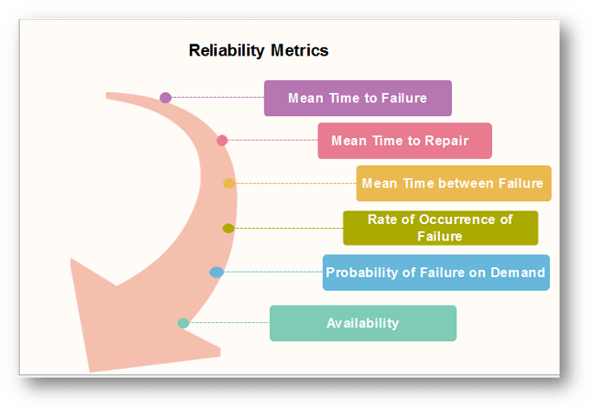
Software Reliability Metrics:-Reliability metrics are used to quantitatively expressed the reliability of the software product. The option of which metric is to be used depends upon the type of system to which it applies & the requirements of the application domain.
Some reliability metrics which can be used to quantify the reliability of the software product are as follows:

Slide 125

1. Mean Time to Failure (MTTF)
MTTF is described as the time interval between the two successive failures. An MTTF of 200 mean that one failure can be expected each 200-time units. The time units are entirely dependent on the system & it can even be stated in the number of transactions. MTTF is consistent for systems with large transactions.
For example, It is suitable for computer-aided design systems where a designer will work on a design for several hours as well as for Word-processor systems.
To measure MTTF, we can evidence the failure data for n failures. Let the failures appear at the time instants t₁,t₂.....t_{n}.
MTTF can be calculated as

Slide 126
2. Mean Time to Repair (MTTR)
Once failure occurs, some-time is required to fix the error. MTTR measures the average time it takes to track the errors causing the failure and to fix them.
3. Mean Time Between Failure (MTBR)
We can merge MTTF & MTTR metrics to get the MTBF metric.
MTBF = MTTF + MTTR
Thus, an MTBF of 300 denoted that once the failure appears, the next failure is expected to appear only after 300 hours. In this method, the time measurements are real-time & not the execution time as in MTTF.

Slide 127
4. Rate of occurrence of failure (ROCOF):-
It is the number of failures appearing in a unit time interval. The number of unexpected events over a specific time of operation. ROCOF is the frequency of occurrence with which unexpected role is likely to appear. A ROCOF of 0.02 mean that two failures are likely to occur in each 100 operational time unit steps. It is also called the failure intensity metric.
5. Probability of Failure on Demand (POFOD):-
POFOD is described as the probability that the system will fail when a service is requested. It is the number of system deficiency given several systems inputs.
POFOD is the possibility that the system will fail when a service request is made.
A POFOD of 0.1 means that one out of ten service requests may fail. POFOD is an essential measure for safety-critical systems. POFOD is relevant for protection systems where services are demanded occasionally.

Slide 128
6. Availability (AVAIL):-
Availability is the probability that the system is applicable for use at a given time. It takes into account the repair time & the restart time for the system. An availability of 0.995 means that in every 1000 time units, the system is feasible to be available for 995 of these. The percentage of time that a system is applicable for use, taking into account planned and unplanned downtime. If a system is down an average of four hours out of 100 hours of operation, its AVAIL is 96%.

Slide 129
Reliability Allocation Models
Reliability allocation models are mathematical tools used to assign reliability targets to individual components or subsystems of a system, based on a system-level reliability goal, to ensure a well-balanced in all or sub components and achievable design shape. or
Reliability Allocation deals with the setting of reliability goals for individual subsystems such that a specified reliability goal is met, and the hardware and software subsystem goals are well-balanced among themselves.
It involves a balancing act of determining how to allocate reliability to the components in the system so the system will meet its reliability goal while at the same time ensuring that the system meets all of the other associated performance specifications.

Slide 130
Reliability Allocation deals with the setting of reliability goals for individual subsystems such that a specified reliability goal is met and the hardware and software subsystem goals are well balanced among themselves.
Well-balanced usually refers to approximate relative equality of development time, difficulty, risk, or to the minimization of overall development cost.
Types of Reliability Allocation Models:-
The three methods of reliability allocation are Equal Allocation Method, Weighted Allocation Method, and Reliability Based Sparing. Each method serves a purpose based on component importance and system goals. Understanding these methods is essential for effective reliability engineering.
(I)Equal Allocation Method
(II)Weighted Allocation Method
(III)Cost optimization allocation or Reliability Based Sparing

Slide 131
(I)Equal Allocation Method:-
In software engineering, an "equal reliability model" (also known as a simple reliability growth model) assumes that all faults contribute equally to reliability and that each fault repair contributes the same amount of reliability growth.
Or
An "equal reliability model" in the context of reliability engineering and software reliability, refers to a model where components or items within a system are assumed to have the same or equal reliability characteristics, such as failure rates or probabilities.

Slide 132
II)Weighted Allocation Method :-
It is a combination of two model know as a the Software Reliability Growth Models (SRGMs) and Weighted Combinational Models.
In software reliability engineering, a weighted reliability model combines multiple software reliability growth models (SRGMs) using weighted averages to potentially improve prediction accuracy, especially when individual models have limitations.
-Software Reliability Growth Models (SRGMs):
The Software Reliability Growth Models (SRGMs) are mainly used to plan and execute system testing in the Software Development Life Cycle (SDLC).
These models predict the probability of error-free operation of a software system over time, based on the number of bugs and the time it takes to fix them.
-Weighted Combinational Models:
These models take the output of multiple SRGMs and combine them using weights, which can be equal, linear, or nonlinear, to get a more accurate reliability prediction.

Slide 133
Cost/Penalty optimization allocation:
Cost optimization allocation is the process of identifying and assigning costs to specific activities, projects, departments, or other cost objects to understand where money is spent and improve financial transparency and decision-making.
Or
Developing the "cost of reliability" relationship will give the engineer an understanding of which components to improve and how to best concentrate the effort and allocate resources in doing so. The first step will be to obtain a relationship between the cost of improvement and reliability.

Slide 134
Cost Allocation:
This involves identifying all costs incurred by an organization and then assigning them to specific areas (e.g., projects, departments, products).
Cost Optimization:
This is the broader process of reducing and managing expenses while maximizing value and efficiency, often involving cost allocation as a key step.
Formula –finding the Quantifying the Cost/Penalty Function-One needs to quantify a cost function for each component, Ci, in terms of the reliability, Ri, of each component,
Ci=f(Ri)

Slide 135
Model Evaluation Or Criteria for Model Evaluation
Model evaluation is the process of using different evaluation metrics to understand a product performance, as well as its strengths and weaknesses or failure rate of a product.
Model evaluation is important to assess the efficacy of a model during initial research and development phases, and it also plays a role in model monitoring for that product.
Model evaluation is a crucial step in the field of Machine Learning that helps us determine how well a trained model performs on new data. It involves assessing the accuracy, reliability, and overall quality of a model's predictions.

Slide 136
Model evaluation allows us to gauge the effectiveness and efficiency of a trained model.
This process helps us assess the model's ability to generalize and make accurate predictions on unseen data. By understanding the strengths and weaknesses of a model, we can refine it further and enhance its performance.
For reliability models, in 1984 a group of experts (Iannino et al., 1984) devised a set of criteria for model assessment and comparison.
The criteria are listed as follows , by order of importance as determined by the group :

Slide 137
To evaluate software reliability models, you should consider criteria like accuracy, predictive power, and the ability to handle various failure patterns. Also, consider the model's simplicity, computational efficiency and the availability of data for training and validation.
Here, there are various criteria evolution available for a product-
1. Predictive validity
2. Capability
3. Quality of assumptions
4. Applicability
5. Simplicity

Slide 138
1. Predictive validity: The capability of the model to predict failure behavior or the number of defects for a specified time period based on the current data in the model.
2. Capability: The ability of the model to estimate with satisfactory accuracy quantities needed by software managers, engineers , and users in planning and managing software development projects or controlling change in operational software systems.
3. Quality of assumptions: The likelihood that the model assumptions can be met, and the assumptions' plausibility from the view point of logical consistency and software engineering experience.

Slide 139
4. Applicability: The model's degree of applicability across different software Products (size, structure, functions, etc.).
5. Simplicity: A model should be simple in three aspects:
(1) simple and in expensive to collect data.
(2) simple in concept and does not require extensive mathematical background for software development practitioners to comprehend.
(3) readily implemented by computer programs.
From the practitioner's point of view and with recent observations of software reliability models, we contend that the most important criteria are predictive validity, simplicity, and quality of assumptions, in that order of importance. Capability and applicability are less significant.

Slide 140
Key Metrics for Model Evaluation:-
To evaluate a model, various metrics and techniques are employed.
These metrics provide different perspectives on model performance and help us understand the model's behavior:
Accuracy: Measures the percentage of correct predictions made by the model.
Precision: Determines the proportion of true positive predictions out of all positive predictions made by the model.
Recall: Identifies the proportion of true positive predictions out of all actual positive instances in the data.
F1 Score: Represents the harmonic mean of precision and recall, providing a balanced measure of a model's performance.
Confusion Matrix: Illustrates the classification results in a tabular form, enabling us to calculate various evaluation metrics.
Receiver Operating Characteristic (ROC) Curve: Plots the true positive rate against the false positive rate, visually exhibiting the model's performance.
Area Under the Curve (AUC): Quantifies the overall quality of a classification model based on the ROC curve.

Slide 141
Software Quality Assessment Models:-
Software Quality Assessment Models (SQAMs) are frameworks used to evaluate and measure the quality of software products, helping developers and stakeholders understand and improve software performance and reliability.
Or
Software Assessment is a standardized assessment process of software purchases ensures that: Technical and security requirements are met. Adequate resources are available. All requirements and risks are fully identified. Redundancy of software is avoided.

Slide 142
The SQA provides a holistic, unbiased and data-driven assessment, covering not only the quality of the software itself but also the quality of the development process, knowledge distribution and key contributors. Based on evolution and defect removal technique.
Software quality assessment models help evaluate and improve software quality by providing frameworks for identifying, measuring, and managing quality attributes, with popular models including ISO/IEC 9126, McCall's model, Boehm's model, and FURPS.

Slide 143
The various software quality matter where helps to calculating that actually matter-Code quality, Test coverage, Defect density, Mean time to recovery (MTTR), Lead time for changes, Customer-reported bugs, Release frequency, User satisfaction.
Here's a breakdown of some common software quality assessment models:
1. ISO/IEC 9126 (and its successor ISO/IEC 25010):
Defines and evaluates software quality through characteristics like functionality, reliability, usability, efficiency, maintainability, and portability.
ISO/IEC 25010 defines eight quality characteristics for software products and four quality characteristics for software systems.

Slide 144
Example Characteristics: Functional suitability, reliability, performance efficiency, usability, security, compatibility, maintainability, and portability.
2. CMMI (Capability Maturity Model Integration):
Emphasizes process maturity and improvement to enhance software quality indirectly.
Provides a framework for organizations to assess and improve their software development processes.

Slide 145
3. Software Development Models (e.g., Waterfall, V-Model, Agile, Spiral):
Waterfall Model:
A sequential model where each phase (requirements, design, implementation, testing, deployment) must be completed before the next begins.
V-Model:
A testing-oriented model where development and testing activities are carried out side by side, starting with unit testing and progressing to system integration.
Agile Model:
An iterative and incremental model that emphasizes flexibility, customer collaboration, and rapid delivery of working software.
Spiral Model:
A risk-based model that involves multiple iterations, with each iteration focusing on a specific aspect of the project and incorporating risk analysis.

Slide 146
4. Other Quality Assessment Approaches:
IEEE 829: A standard for software documentation, including test plans and procedures.
TQM (Total Quality Management): A holistic approach to quality improvement that involves all aspects of an organization.
Six Sigma: A data-driven methodology for identifying and eliminating defects in processes.
McCall's Model: Defines quality through 11 factors and 23 criteria across three perspectives: Product Operation, Product Revision, and Product Transition.
Boehm's Model: Uses a hierarchical structure of characteristics to assess software quality.
Dromey's Model: Focuses on product-based evaluation through a 5-step process.
FURPS/FURPS+: Divides attributes into functional and non-functional categories.

Slide 147
QUALITY MODELS FOR QUALITY ASSESSMENT
We define quality assessment models as analytical models that provide quantitative assessment of selected quality characteristics or sub-characteristics based on measurement data from software projects. These models can help us obtain an objective assessment of our current product quality, in contrast to the often unreliable subjective assessment based on personal judgment or imprecise qualitative assessment.
When applied over time, these models can provide us with an accurate prediction of the future quality, which can be used to help us make project scheduling, resource allocation, and other management decisions.

Slide 148
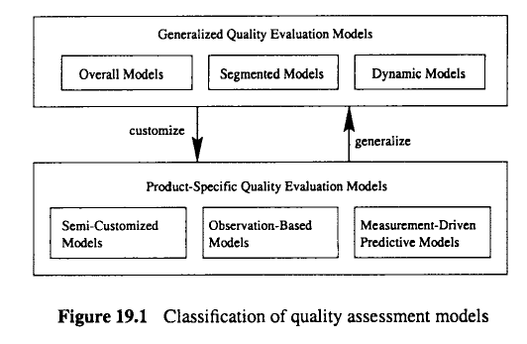
Classification of quality assessment models

Slide 149
Classification of quality assessment models- There are two types of Quality Model for Quality Assessment-
1. GENERALIZED MODELS
2. PRODUCT-SPECIFIC MODELS
1. GENERALIZED MODELS:-
Many existing models provide rough estimates of product quality in the form of industrial averages or general trends for a wide variety of application environments with little or no project-specific data required. We call these models generalized quality assessment models, or generalized models for short.
There are three subcategories of generalized models:
1. An overall model 2. A segmented model 3. A dynamic model
1. 1. An overall model :- An overall model provides a single estimate of overall product quality. Overall quality models are the most general subtype of generalized quality models, which provide a rough estimate of product quality without requiring any product specific measurement or even a general characterization of the product segment.

Slide 150
Because of this general nature, such models only provide a very rough estimate of product quality. However, if some additional information is available about the product under study, better quality estimated can be provided by alternative models.
As an example of overall models, defect density can be defined as:
defect density = total defects/ product size
where the product size is often measured by the lines of code (LOC), function points, etc.
(Kan, 2002). This model would lump all products together, and provide a single defect density estimate based on all observed defects for all products. Various product sizing
models can also be used in conjunction with defect density to estimate the total defects for a given product.

Slide 151
2. A segmented model :- A segmented model provides different quality estimates for different industrial segments.
If some general information about the product under study is available, we can use segmented models instead of overall models to get a better quality estimate.
For example, the above defect density model can be refined into a segmented model if we use market segmentation to group products and provide different defect density estimates accordingly.
Similarly, sizing models tailored for different product segments can be used with such defect density models to estimate the total defects for a given product.
Table 19.1 gives another example of segmented models, based on empirical data (Leveson,1995; Lyu, 1995a), which estimates reliability levels for different product segments.
There are three products segments: 1) safety-critical software, such as control software for medical devices or nuclear reactors, 2) commercial software, such as telecommunication software and business applications, and 3) auxiliary software, such as computer games
and other low-cost PC software. The reliability level is measured by the failure rate, or the average number of failures per operating hour.

Slide 152
3. A dynamic model :-provides quality trend or distribution over time or development phases.
As a subset of generalized models, the dynamic models provide information about quality over time or development phases. For example, a general profile of defect distribution over different development phases can be considered a quality model of this type.
Alternatively, fine grain dynamic models may measure the precise time instead of the rough time corresponding to development phases. The most well-known model in this category is the Putnam model (Putnam, 1978), that generalizes empirical effort and defect profiles over time into a Rayleigh curve.
with failure rate r = 2Bc~te-"~*
or, equivalently, with cumulative failures F = B( 1 - e--at2).
Various other general observations about systems dynamic behavior related to defects or quality can also be considered as examples of dynamic models.

Slide 153
2. PRODUCT-SPECIFIC MODELS
Product-specific quality assessment models, or product-specific models for short, provide more precise quality assessments using product-specific data. They can be further divided into three sub-categories:
1. Semi-customized models extrapolate product history to predict quality for the current project.
2. Observation-based models estimate quality based on observations from the current project.
3. Measurement-driven predictive models establish predictive relations between various early measurements and product quality, and use them for QA and improvement.

Slide 154
1. Semi-customized models make use of general characteristics and historical information about the product, process, or environment, to provide quality extrapolations. For example,
various defect removal models (DRMs) commonly used in industry (Kan, 2002), such as the one in Table 19.2, provide a defect distribution profile over development phases based on previous releases of the same product. The difference between this DRM and the general
defect profile we mentioned in the above generalized dynamic models is that it is based on the previous releases of the same product instead of a general profile for all available products. Consequently, the use of this relevant local information can help provide more accurate quality estimates.
The information from these semi-customized models can be directly used to predict defect distribution for the current release. For example, with the DRM in Table 19.2, if we have found 20 design defects in the current product, we can predict that the total defects will be around 20/10% = 200.

Slide 155
Observation-based models relate observations of the software system behavior to information about related activities to provide more precise quality assessments. Examples of such models include various software reliability growth models (SRGMs) (Lyu, 1995a), where
observed failures and associated time intervals are fitted to SRGMs to evaluate product reliability. For example, in the Goel-Okumoto SRGM (Goel and Okumoto, 1979), the
relationship between the expected number of failures m(t) and testing time t is given by the function:
m(t)= ~ (- 1e--b t).
N and b are model parameters that can be estimated from the observation data.

Slide 156
Measurement-driven predictive models
Measurement-driven predictive models establish predictive relations between quality and other measurements based on historical data, provide early predictions of quality, and identify problems early so that timely actions can be taken to improve product quality.
Various statistical analysis techniques and learning algorithms can be used to establish such predictive relations (Tian, 2000), which are covered in Chapter 21.
Once such predictive relations are established, we can affect the development process by using them to identify high-risk areas for focused remedial actions.

Slide 157
SELECTING MEASUREMENTS AND MODELS
Based on the characteristics of quality assessment models and the relationships between these models and relevant measurements discussed above, we next outline an approach for measurement and model selection, and illustrate it with some practical examples.

Slide 158
Using this approach, we can follow the following three steps to set quality goals and select appropriate models
and measurements:
Step 1. Set specific model uality goals. For example, if we are concerned with problem-free
services, reliability measurement and improvement should be the goal. This step
restricts the “G” in the GQM-paradigm to specific quality goals instead of general
measurement goals.
Step 2. Choose spec@c quality assessment models that can answer our questions and concerns
about the quality goals under the constraints of the application environment. For
example, if we need precise reliability estimates, we can consider using SRGMs. This
step roughly corresponds to “Q’ in the GQM-paradigm, but the model classification
scheme in this chapter is used to select appropriate quality assessment models.
QUALITY MODELS AND MEASUREMENTS
Step 3. Choose appropriate measurements based on the model data requirements. For
example, we can take failure and test execution time measurements in order to evaluate
product reliability using SRGMs. This step roughly corresponds to “M’ in the GQMparadigm,
but the model-data relations summarized in Figure 19.3 are used to select
appropriate measurements.
We next consider actual scenarios during the testing ofof several large commercial software
systems developed in IBM (Tian, 1998) to illustrate the use of this approach. These
systems include relational data base products, compilers, and computing environments, for
platforms ranging from mainframes to PCs. They can be characterized by their large size,
usually exceeding several hundred thousand lines of source code, high complexity, diverse
functionality, and components developed over a long period of time. The overall testing
effort usually lasts from over several months to more than a year.

